Slide 1
Implementation of ORCiD:
Why, How, and Potential Pitfalls
a guided discussion!
Notes:
Ashley to introduce presenters and ask participants to mute microphones.
Participants can chime in using the chat box or raising their hand to be called on to talk, unmute their phones and contribute

Slide 2
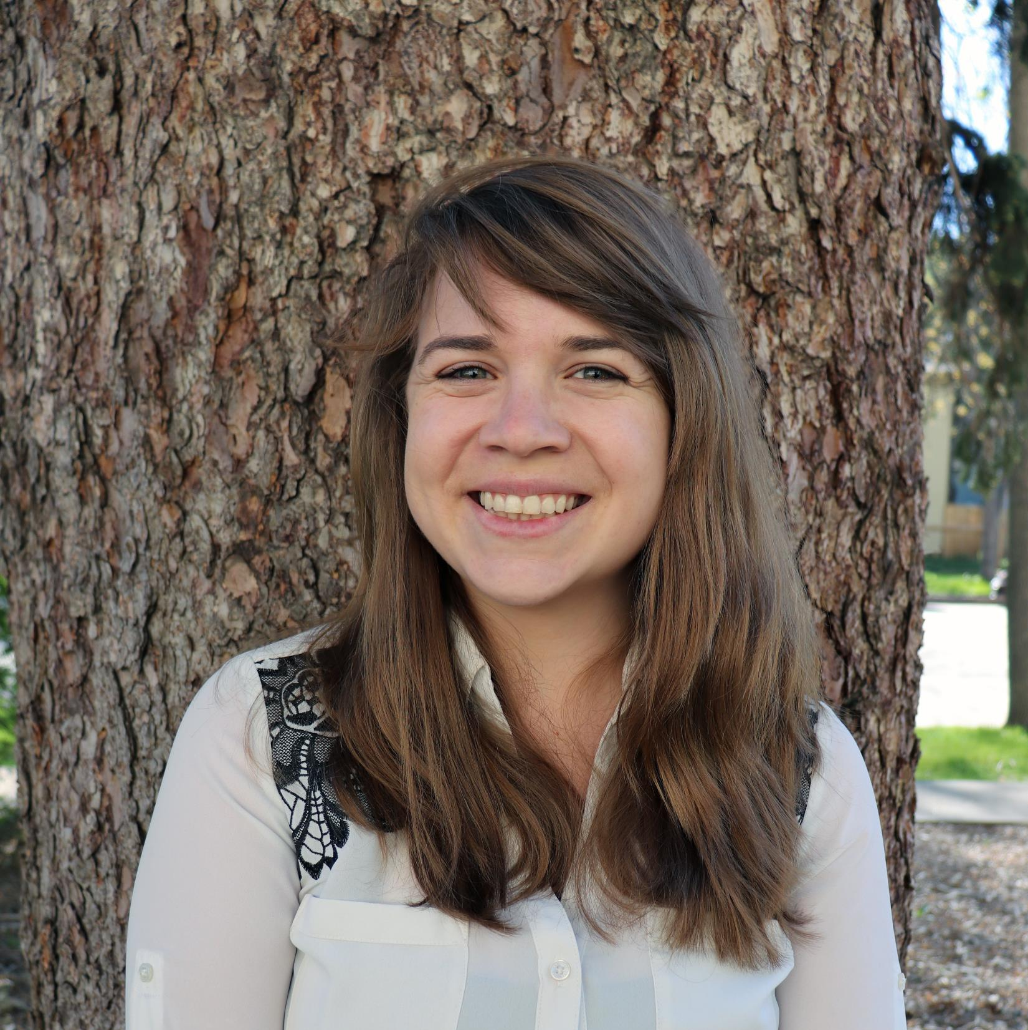
Meet the Discussion Leaders
Beth Kingsley Grants Contract Manager
Denver Health
Liz Grinstead Senior Research Administrator
Colorado State University

Slide 3
What is ORCiD?
Open Researcher and Contributor IDentifier (ORCiD)
Provides a persistent digital identifier (an ORCiD iD) that distinguishes someone from other researchers and a record that supports automatic links among all their professional activities.
ORCiD is designed to be a career-long identifier.
Notes:
Provide an example:
Dave Doty at CSU; David Doty at UNL

Slide 4
Why ORCiD?
Author benefits
Sponsor requirement
Notes:
Elaborate on bullets

Slide 5
About ORCiD
Registration is free!
Researchers can link their ORCiD iD with eRA Commons and SciENcv, along with many other third-party systems
Encourage ALL your researchers, from Graduate Students to Senior Scientists, to register if they haven't already.

Slide 6
How Do I Register an Investigator?
https://orcid.org/register
Note: Per ORCiD's terms and conditions, you may only register for an ORCiD iD for yourself.

Slide 7
Let’s Discuss!
Notes:
List some questions here to start discussion.
How many of you have assisted an investigator in obtaining an ORCiD?
Can anyone talk about the amount of time it took to complete the ORDid or ease/difficulty in doing so?
What issues or challenges did you encounter?
What help is your institution providing investigators with the ORCiD?

Slide 8
I want more information! Where can I go?
https://www.colorado.edu/ocg/sites/default/files/attached-files/orcid_step-by-step_instructions.pdf
University of Colorado Boulder’s Step by Step Guide
THANK YOU KRISTI WINSECK!!!!
https://nexus.od.nih.gov/all/2020/01/06/important-reminders-for-fellowship-and-career-development-applicants/
Information from NIH for Fellowship and Career Development Applications
https://nexus.od.nih.gov/all/2019/08/05/linking-orcid-identifiers-to-era-profiles-to-streamline-application-processes-and-to-enhance-tracking-of-career-outcomes/
Open Mike Blog Post from 8/5/2019 (NIH)
https://grants.nih.gov/grants/guide/notice-files/NOT-OD-19-109.html
NIH Notice NOT-OD-19-109 ORCiD requirement

Slide 9
Questions about this Discussion?
Contact the Leaders:
Liz Grinstead at Liz.Grinstead@colostate.edu
Beth Kingsley at Elizabeth.Kingsley@dhha.org
Have a topic you want to see presented or discussed?
Contact the Region VII PEDC with your ideas:
OSP_info@mail.colostate.edu

Slide 10
We Appreciate Your Feedback!
http://colostate.az1.qualtrics.com/jfe/form/SV_cCjPwoCz2YRyM5L
Click this link to access the survey!

Slide 11
SAVE THE DATE
Next up on the Region VII PEDC Sessions:
Guided discussion on Teleworking: Policies, Operational Needs & Best Practice
March 26th, 12:00 – 1:00 MST
Look for the dial in information email coming soon!

